Slide 1
Lecture 32
Risk Management (Cont’d)

Slide 2
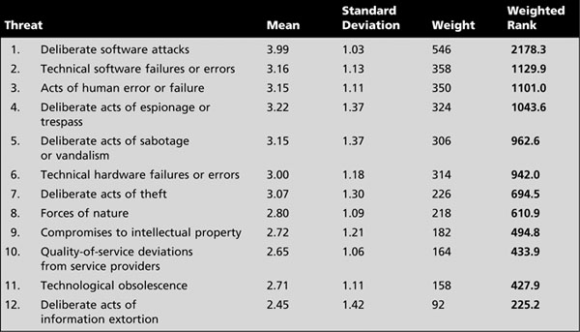
Threat Identification (cont’d.)
Weighted ranks of threats to information security
Source: Adapted from M. E. Whitman. Enemy at the gates: Threats to information security. Communications of the ACM, August
2003. Reprinted with permission
Management of Information Security, 3rd ed.

Slide 3
Threat Identification (cont’d.)
Vulnerability Assessment
  Begin to review every information asset for each threat
  This review leads to the creation of a list of vulnerabilities that remain potential risks to the organization
    Vulnerabilities are specific avenues that threat agents can exploit to attack an information asset
  At the end of the risk identification process, a list of assets and their vulnerabilities has been developed
Management of Information Security, 3rd ed.

Slide 4
Threat Identification (cont’d.)
Vulnerability Assessment (cont’d.)
  This list serves as the starting point for the next step in the risk management process - risk assessment
Management of Information Security, 3rd ed.

Slide 5
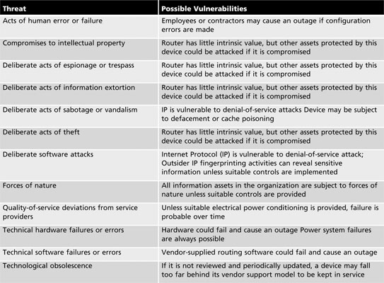
Threat Identification (cont’d.)
Table 8-4 Vulnerability assessment of a DMZ router
Management of Information Security, 3rd ed.
Source: Course Technology/Cengage Learning

Slide 6
The TVA Worksheet
At the end of the risk identification process, a list of assets and their vulnerabilities has been developed
Another list prioritizes threats facing the organization based on the weighted table discussed earlier
These lists can be combined into a single worksheet
Management of Information Security, 3rd ed.

Slide 7
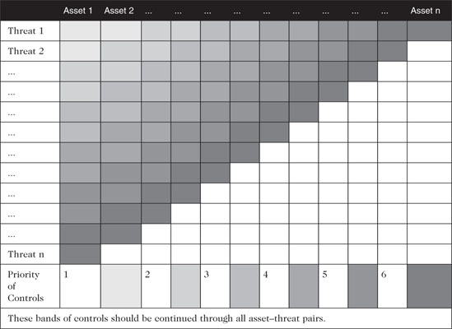
The TVA Worksheet (cont’d.)
Table 8-5 Sample TVA spreadsheet
Management of Information Security, 3rd ed.
Source: Course Technology/Cengage Learning

Slide 8
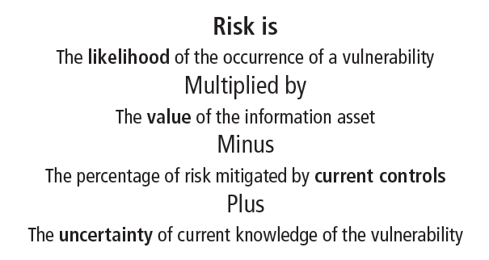
Introduction to Risk Assessment
The goal is to create a method to evaluate the relative risk of each listed vulnerability
Figure 8-3 Risk identification estimate factors
Management of Information Security, 3rd ed.
Source: Course Technology/Cengage Learning

Slide 9
Likelihood
The overall rating of the probability that a specific vulnerability will be exploited
  Often using numerical value on a defined scale (such as 0.1 – 1.0)
Using the information documented during the risk identification process, you can assign weighted scores based on the value of each information asset, i.e. 1-100, low-med-high, etc
Management of Information Security, 3rd ed.

Slide 10
Assessing Potential Loss
Questions to ask when assessing potential loss
  Which threats present a danger to this organization’s assets in the given environment?
  Which threats represent the most danger to the organization’s information?
  How much would it cost to recover from a successful attack?
Management of Information Security, 3rd ed.

Slide 11
Assessing Potential Loss (cont’d.)
Questions to ask when assessing potential loss (cont’d.)
  Which threats would require the greatest expenditure to prevent?
  Which of the aforementioned questions is the most important to the protection of information from threats within this organization?
Management of Information Security, 3rd ed.

Slide 12
Percentage of Risk
Mitigated by Current Controls
If a vulnerability is fully managed by an existing control, it can be set aside
If it is partially controlled, estimate what percentage of the vulnerability has been controlled
Management of Information Security, 3rd ed.

Slide 13
Uncertainty
It is not possible to know everything about every vulnerability
The degree to which a current control can reduce risk is also subject to estimation error
Uncertainty is an estimate made by the manager using judgment and experience
Management of Information Security, 3rd ed.

Slide 14
Risk Determination
Example
  Asset A has a value of 50 and has one vulnerability, which has a likelihood of 1.0 with no current controls. Your assumptions and data are 90% accurate
  Asset B has a value of 100 and has two vulnerabilities: vulnerability #2 has a likelihood of 0.5 with a current control that addresses 50% of its risk; vulnerability # 3 has a likelihood of 0.1 with no current controls. Your assumptions and data are 80% accurate
Management of Information Security, 3rd ed.

Slide 15
Risk Determination (cont’d.)
Example (cont’d.)
  The resulting ranked list of risk ratings for the three vulnerabilities is as follows:
    Asset A: Vulnerability 1 rated as 55 = (50 × 1.0) – 0% + 10%
    Asset B: Vulnerability 2 rated as 35 = (100 × 0.5) – 50% + 20%
    Asset B: Vulnerability 3 rated as 12 = (100 × 0.1) – 0 % + 20%
Management of Information Security, 3rd ed.

Slide 16
Likelihood and Consequences
Likelihood and consequence rating
  Another approach
  From the Australian and New Zealand Risk Management Standard 4360i
  Uses qualitative methods of determining risk based on a threat’s probability of occurrence and expected results of a successful attack
Management of Information Security, 3rd ed.

Slide 17
Likelihood and
Consequences (cont’d)
Likelihood and consequence rating (cont’d.)
  Consequences (or impact assessment) are evaluated on 5 levels ranging from insignificant (level 1) to catastrophic (level 5), as assessed by the organization
  Qualitative likelihood assessments levels are represented by values ranging from A (almost certain) to E (rare), as determined by the organization
Management of Information Security, 3rd ed.

Slide 18
Identify Possible Controls
For each threat and its associated vulnerabilities that have residual risk, create a preliminary list of control ideas
Three general categories of controls exist:
  Policies
  Programs
  Technical controls
Management of Information Security, 3rd ed.

Slide 19
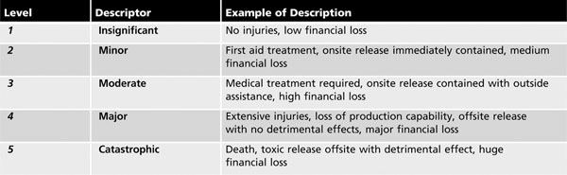
Likelihood and Consequences (cont’d.)
Table 8-6 Consequence levels for organizational threats
Management of Information Security, 3rd ed.
Source: Risk management plan templates and forms from www.treasury.act.gov.au/actia/Risk.htm

Slide 20
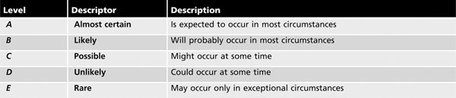
Likelihood and Consequences (cont’d.)
Table 8-7 Likelihood levels for organizational threats
Management of Information Security, 3rd ed.
Source: Risk management plan templates and forms from www.treasury.act.gov.au/actia/Risk.htm

Slide 21
Likelihood and Consequences
(cont’d.)
Consequences and likelihoods are combined
  Enabling the organization to determine which threats represent the greatest danger to the organization’s information assets
The resulting rankings can then be inserted into the TVA tables for use in risk assessment
Management of Information Security, 3rd ed.

Slide 22
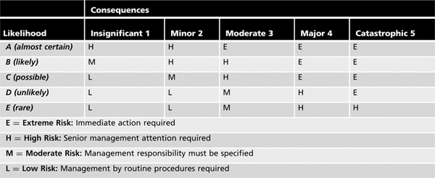
Likelihood and Consequences (cont’d.)
Table 8-8 Qualitative risk analysis matrix
Management of Information Security, 3rd ed.
Source: Risk management plan templates and forms from www.treasury.act.gov.au/actia/Risk.htm

Slide 23
Documenting the Results of Risk Assessment
Goals of the risk management process
  To identify information assets and their vulnerabilities
  To rank them according to the need for protection
In preparing this list, a wealth of factual information about the assets and the threats they face is collected
Management of Information Security, 3rd ed.

Slide 24
Documenting the Results of Risk Assessment (cont’d.)
Information about the controls that are already in place is also collected
The final summarized document is the ranked vulnerability risk worksheet
Management of Information Security, 3rd ed.

Slide 25
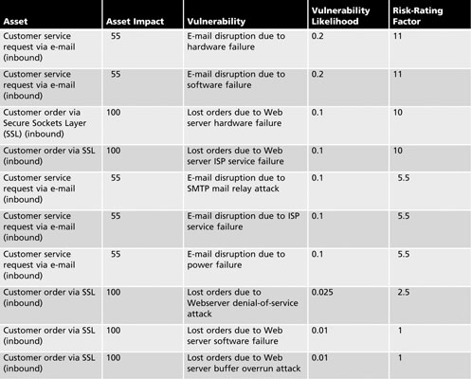
Table 8-9 Ranked vulnerability risk worksheet
Management of Information Security, 3rd ed.
Source: Course Technology/Cengage Learning

Slide 26
Documenting the Results of Risk Assessment (cont’d.)
What should the documentation package look like?
What are the deliverables from this stage of the risk management project?
The risk identification process should designate what function the reports serve, who is responsible for preparing them, and who reviews them
Management of Information Security, 3rd ed.

Slide 27
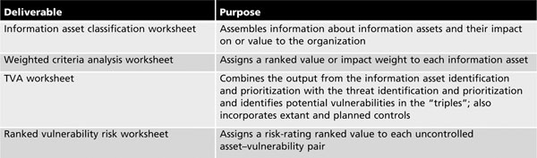
Documenting the Results of Risk Assessment (cont’d.)
Table 8-10 Risk identification and assessment deliverables
Management of Information Security, 3rd ed.
Source: Course Technology/Cengage Learning

Slide 28
Summary
Introduction
Risk management
Risk identification
Risk assessment
Documenting the results of risk assessment
Management of Information Security, 3rd ed.

